Slide 1
MODULE I
ENVIRONMENT AND ECOSYSTEMS
LECTURE III

Slide 2
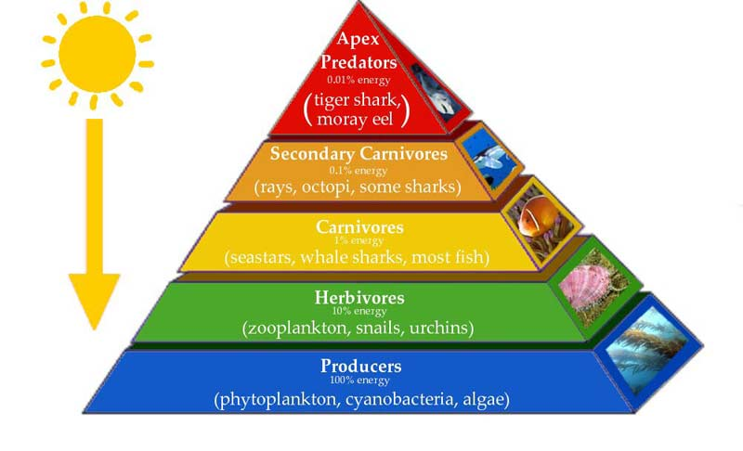
ECOLOGICAL PYRAMIDS
It is a graphic representation of the relationship between organisms at various trophic levels in a food chain.
The basis of an ecological pyramid is the biomass, energy, and number. Just as the name suggests ecological pyramids are in the shape of a pyramid.
The concept was first introduced by Charles Elton, the pioneer British Ecologist.
The bottom of an ecological pyramid is the broadest and is occupied the producers, which form the first trophic level.

Slide 3
ECOLOGICAL PYRAMIDS
Producers are at the lowest level. Just as in a food chain, the producers are consumed by the primary consumers, in an ecological pyramid the next level is occupied by the primary consumers.
The next level of the pyramid is occupied by the secondary consumers and the last, by the tertiary consumers.
Ecological pyramids are classified into three

Slide 4
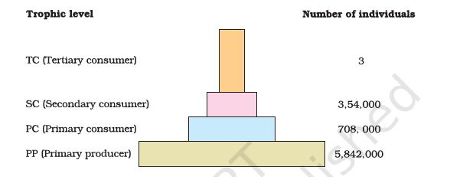
ECOLOGICAL PYRAMIDS
1. PYRAMID OF NUMBERS:
Here the factor that is taken into account is the number of organisms in each trophic level.
As we go up the levels of the pyramid, the number of organisms decreases. The producers form the largest number and hence are at the bottom of the pyramid.
Pyramid of numbers in a grassland ecosystem. Only three top carnivores are supported in an ecosystem based on a production of nearly 6 million plants

Slide 5
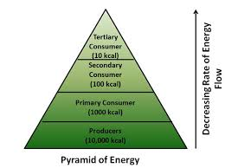
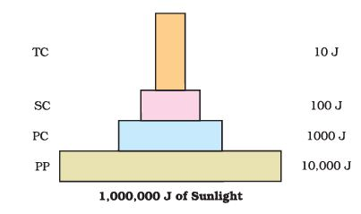
ECOLOGICAL PYRAMIDS
B. PYRAMID OF ENERGY:
This is an upright pyramid that represents the flow of energy from the producers to the final consumers.

Slide 6
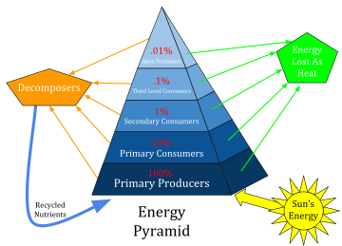
ECOLOGICAL PYRAMIDS
PYRAMID OF ENERGY - 10 Percent Energy Rule
Even though primary consumers feed on producers, they are still getting their energy from the sun.
As the primary consumers feed on plant and break down the food particles to release the energy.
Primary consumers do not get 100% of the sun’s energy from the producers as only some amount of the sun’s energy is utilized by the plant to synthesize their food. In fact, they only get 10% of the energy.
This is termed as the 10% Rule, which states that only 10 per cent of the energy available gets passed onto the next level of consumers.

Slide 7
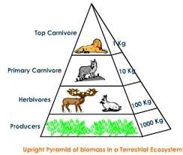
ECOLOGICAL PYRAMIDS
Pyramid of biomass –
This pyramid represents the amount of biomass of the organisms present at each trophic level. Biomass is nothing but the weight of the organisms.
A pyramid of biomass is a graphical representation of biomass present in a unit area of various trophic levels.
There are two main types of biomass pyramid – inverted pyramid of biomass and the upright one.
For most ecosystems on land, the pyramid of biomass has a large base of primary producers with a smaller trophic level perched on top.

Slide 8
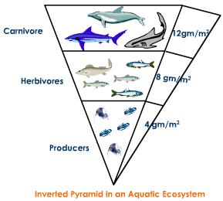
ECOLOGICAL PYRAMIDS
Pyramid of biomass –
A good example of the inverted pyramid is in a aquatic ecosystem
where the mass of phytoplankton, the major producers, will always be lower than the mass of the heterotrophs like fish and insects.
As the value of biomass become larger, the pyramid gains an inverted shape with tertiary consumers appearing at the top in biomass.

Slide 9
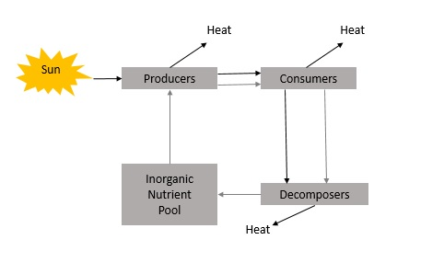
ENERGY FLOW IN ECOSYSTEMS
ENERGY FLOW–
The energy flow in the ecosystem is one of the major factors that support the survival of such a great number of organisms.
The primary source of energy is the solar energy.
Receive less than 50 percent of the sun’s effective radiation on earth. This effective radiation is termed as the Photo synthetically Active Radiation (PAR)
NB: Effective Radiation :Radiation which can be used by plants to carry out photosynthesis.
Around 2-10 percent of it is used by plants for the process of photosynthesis.

Slide 10
ENERGY FLOW IN ECOSYSTEMS
ENERGY FLOW–
This percent of PAR supports the entire world as plants are the producers in the ecosystem.
All the other organisms are either directly or indirectly dependent on them for their survival. Then followed by the secondary consumers.
The flow of energy through ecosystem is unidirectional and non cyclic.
The one way flow of energy in ecosystem is governed by laws of thermodynamics
a. Energy is neither created nor destroyed but may transferred from one form to another.
b. During the energy transfer there is a degradation of energy from a concentrated form to a dispersed form

Slide 11
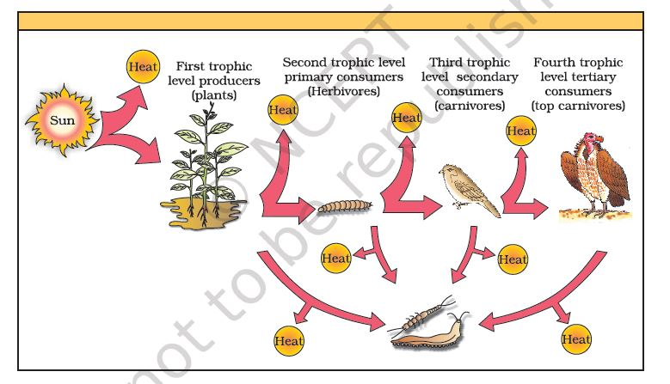
ENERGY FLOW IN ECOSYSTEMS

Slide 12
ENEYGY FLOW
There is continuous loss of energy within each trophic level, From producers to consumers. The energy dissipated as heat during the metabolic activity of organism present in the food chain.
Energy is required for maintaining life activities.

